Slide 1

g
BATCH NO: 08
MINI-PROJECT-REVIEW 3
TALKSPIRE
Submitted by: Under the Guidance
E.SPANDANA 21UP1A0527 of
M.MANASA LALITHA 22UP5A0547 MR.R.KRISHNA NAYAK
A.GEETHANJALI 21UP1A0502 ASSISTANT PROFESSOR

Slide 2
CONTENTS:
ABSTRACT
INTRODUCTION
EXISTING SYSTEM
PROPOSED SYSTEM
SYSTEM ARCHITECTURE
SYSTEM REQUIREMENTS
METHODOLOGY
UML DIAGRAMS
IMPLEMENTATION
EXECUTION AND OUTPUT SCREEN
RESULTS
CONCLUSION AND FUTURE SCOPE

Slide 3
ABSTRACT:
TALKSPIRE is an innovative chatbot application built using the MERN stack, which includes MongoDB, Express, React, and Node.js. It leverages the Gemini API to provide accurate and prompt answers to user queries. Users can interact with the chatbot in multiple ways by typing their questions, speaking them aloud, or even uploading images for analysis. The app incorporates speech-to-text functionality, allowing users to convert spoken questions into text seamlessly. Additionally, it features text-to-speech capabilities, enabling the chatbot to read out answers, thus facilitating a hands-free interaction experience.

Slide 4
Introduction:
This innovative application supports multiple modes of interaction, allowing users to type their questions, speak them aloud, or upload images for analysis, making it highly versatile and user-friendly.
One of the standout features of TALKSPIRE is its speech-to-text functionality, which enables users to convert spoken questions into text seamlessly.
This feature is particularly useful for hands-free operation, enhancing accessibility for users on the go or those who prefer speaking over typing. Complementing this is the text-to-speech capability, which allows the chatbot to read out answers.
It includes features for signing up and logging in, ensuring that each user's chat history is securely stored and accessible only to them.
The chat history is organized by date, making it easy for users to review their past interactions on specific days.

Slide 5
EXISTING SYSTEM:
Current chatbot systems typically rely on either text-based or limited speech-to-text interactions, lacking advanced generative AI capabilities. These systems often do not support image-based queries and may have limited functionality in managing and retrieving chat history, leading to a less versatile and engaging user experience.
LIMITATIONS OF EXISTING SYSTEM:
Inadequate Chat History Management: Many chatbots lack efficient systems for managing and retrieving chat history, making it difficult for users to review past conversations.
Limited Image-Based Queries: Existing chatbots typically support limited image based queries, preventing users from uploading images to receive relevant information.

Slide 6
PROPOSED SYSTEM:
Advanced Text-to-Speech: Responses will be read out loud, enhancing accessibility and engagement.
Image-Based Queries: Users can upload images to receive relevant information, expanding query scope.
Secure Chat History Storage: Chat history will be securely stored and organized by date for easy retrieval.
User Privacy and Data Security: Measures will be implemented to protect user information.

Slide 7
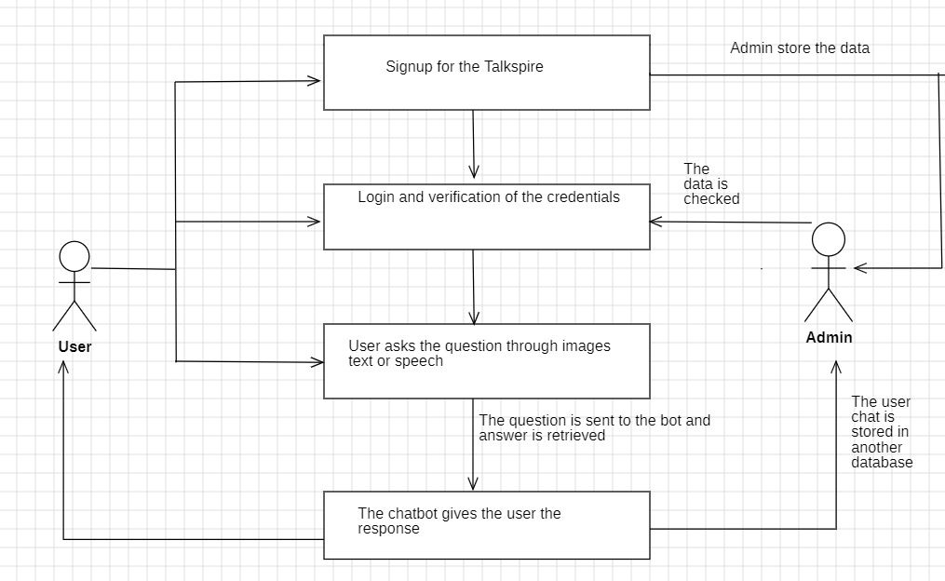
SYSTEM ARCHITECTURE :

Slide 8
SYSTEM REQUIREMENTS:
Software Requirements: Computer software, or simply software, is a collection of data or computer instructions that tell the computer how to work. This is in contrast to physical hardware, from which the system is build and actually performs the work.
• Front End- JavaScript, HTML, CSS, ReactJS
• Back End- JavaScript, NodeJS, ExpressJS, MonogoDB
• Text Editors- VS Code Editor
Hardware Requirements: Hardware is a term that refers to all the physical parts that make up a computer. The internal hardware devices that make up the computer. Various devices which are essentials to form a hardware is called as components.
Following are the hardware specifications that is required to develop this project is as follows:
Computer components like Monitor, Keyboard, Mouse, CPU, Keyboard.
2. Minimum 8 GB ram for smooth working of application.
3. 512 GB Hard Disk or More. CD ROM Drive.

Slide 9
METHODOLOGY
Module 1: Establish requirements, design UI, and define chatbot functionality for optimal user experience.
Module 2: Create user interface, Login page , Sign Up Page, integrate chatbot, and test frontend functionalities for usability.
Module 3: Develop backend, integrate APIs, and implement NLP functionality for chatbot intelligence.
Module 4: Combine frontend and backend, conduct system testing, debug, and deploy application for users.

Slide 10
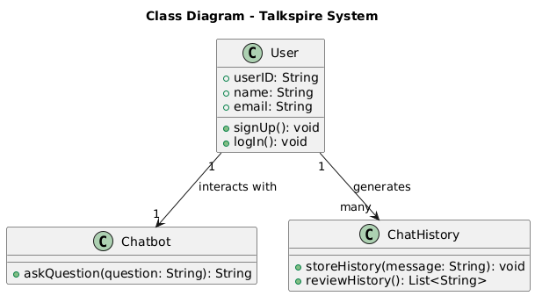
UML DIAGRAMS:

Slide 11
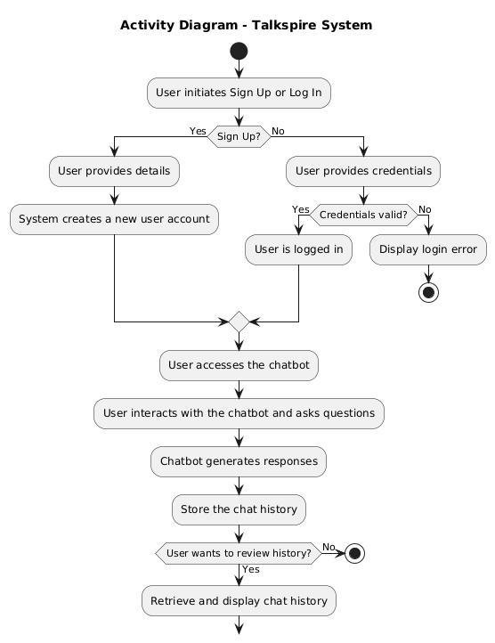

Slide 12
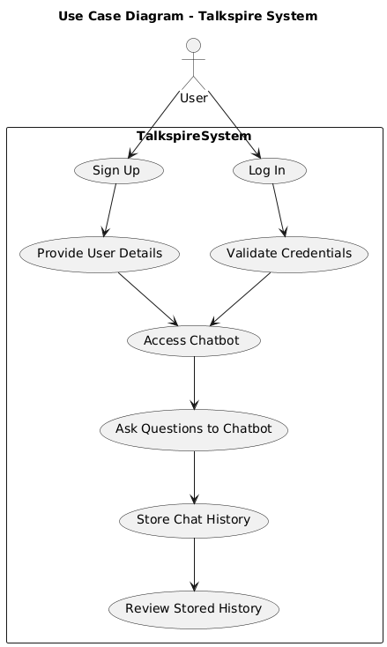

Slide 13
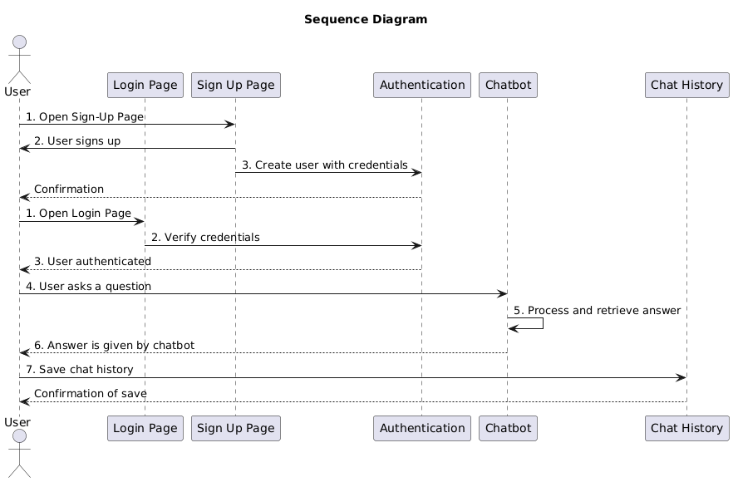

Slide 14
IMPLEMENTATION:
Home Page:
Show a welcome message.
Provide buttons to navigate to the login or signup pages.
Login Page:
User enters email and password.
Send details to the server.
If valid, redirect to the bot page.
If invalid, show an error message.
SignUp Page:
User enters name, email, password, and confirm password.
Check if passwords match.
Send details to the server.
If successful, redirect to the login page.
If an error, show a message.
Styling:
Center content with a nice background.
Style buttons and inputs for a clean look.
Add hover effects for interactivity.

Slide 15
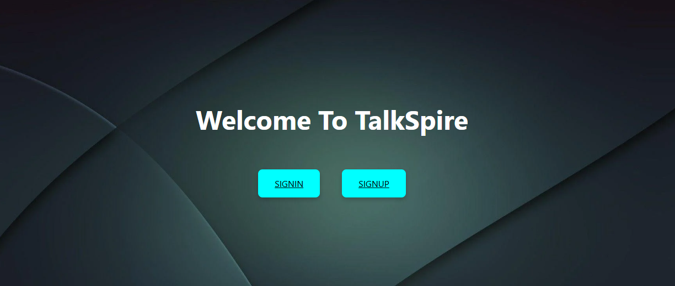
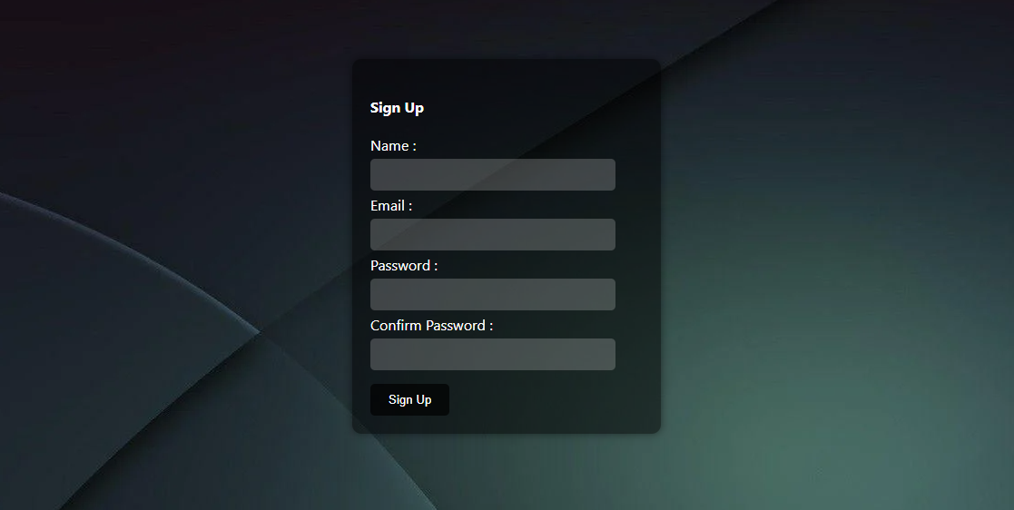
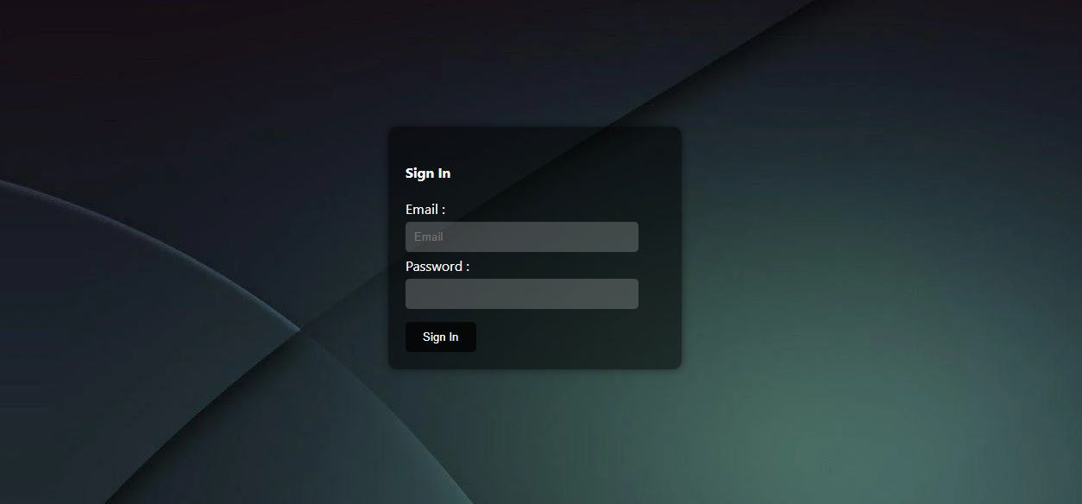
EXECUTION AND OUTPUT SCREEN:

Slide 16
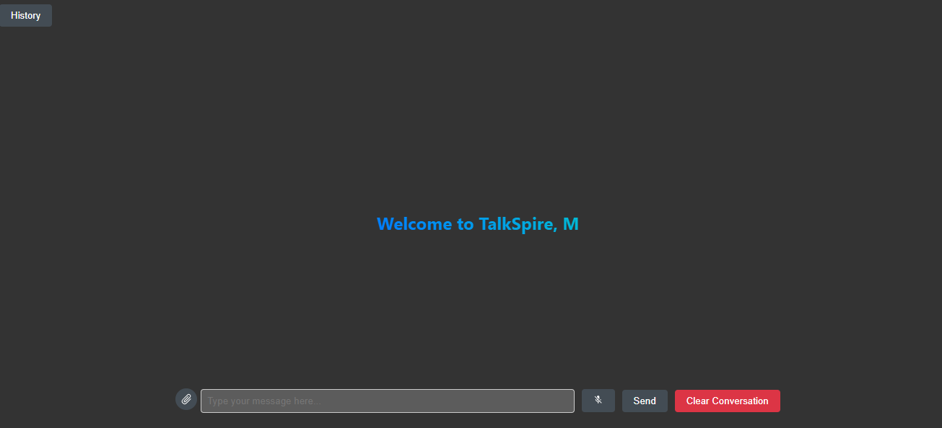
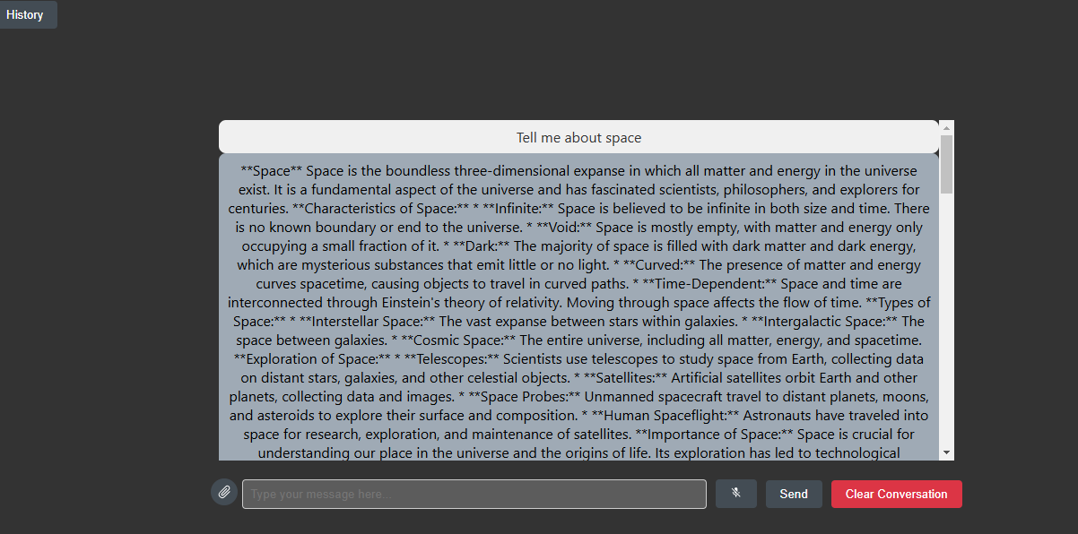
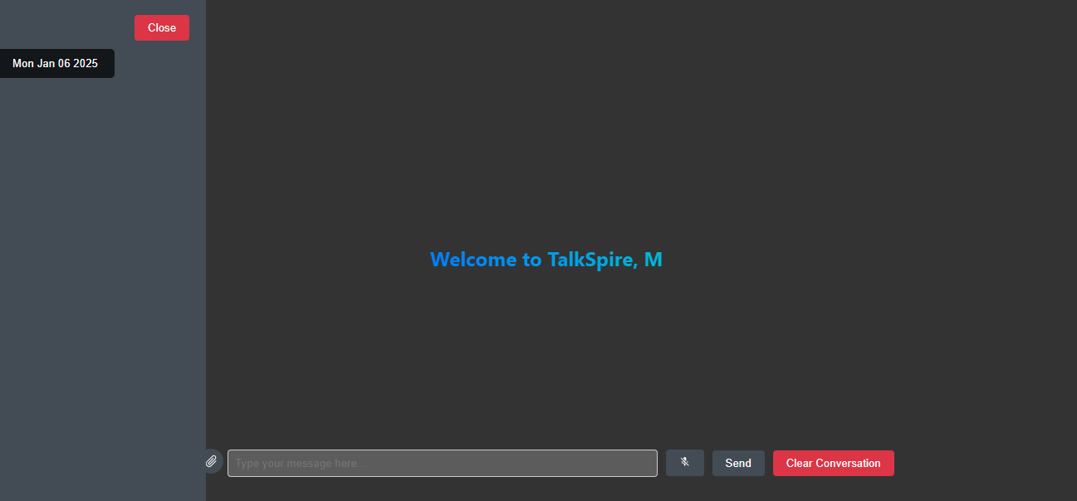

Slide 17
RESULTS:
The integration of real-time chat functionality in TalkSpire has revolutionized user interaction, providing instant responses and fostering dynamic conversations.
This enhancement has not only improved user satisfaction but also enhanced the overall functionality and usability of the application.
By integrating real-time chat, TalkSpire has become a more valuable tool for users seeking information and assistance.
The seamless communication between users and the chatbot has significantly streamlined the user experience, making it easier and more efficient to obtain relevant information.

Slide 18
CONCLUSION AND FUTURE SCOPE:
The integration of real-time chat functionality in TALKSPIRE has greatly improved user interaction by providing instant responses and dynamic conversations.
This feature has significantly enhanced user satisfaction and the overall usability of the application.
With real-time chat, TALKSPIRE has become a more valuable tool for users seeking information and assistance.
Seamless communication between users and the chatbot has streamlined the user experience, making information retrieval more efficient.
In conclusion, the real-time chat functionality, coupled with ongoing improvements, will solidify TALKSPIRE position in the market.
The application's ability to provide instant, accurate responses and seamless user interaction makes it an indispensable tool.
As TALKSPIRE evolves, it will continue to meet the diverse needs of its users, ensuring high satisfaction and engagement, thereby setting a new standard for chatbot applications.
Further development efforts will refine the user experience and expand TALKSPIRE capabilities. By maintaining a focus on user-centric design and innovative features, TALKSPIRE is set to remain a premier chatbot application, delivering unmatched convenience and efficiency to users.

Slide 19
THANK YOU

